Slide 1
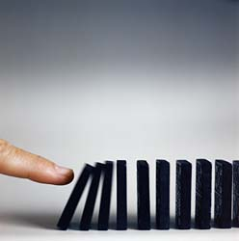
It just takes one….
to make a difference!
By: Cyndi Summers
http://www.youtube.com/watch?v=j9m1JzTdrS0&feature=related

Slide 2
http://www.youtube.com/watch?v=-rnr2EWyO98
One action can cause a chain reaction……..

Slide 3
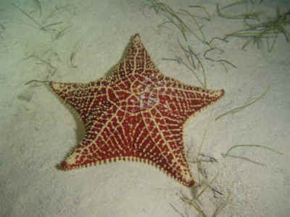
http://www.youtube.com/watch?v=9nZkq31J-GY
“ I made a difference to that one!"
We can do no great things; only small things with great love.
Mother Teresa

Slide 4
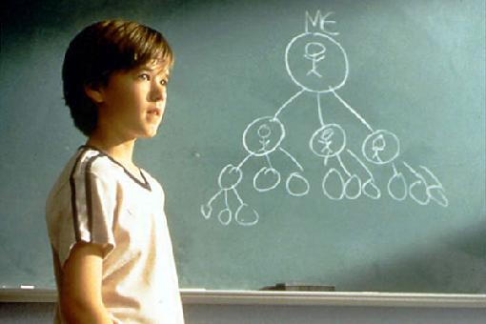
Pay it forward!

Slide 5
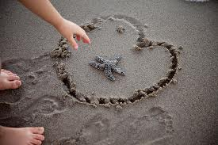
There is something very special in each and every one of us, and we must each find our own starfish.
Each of us is but one person: limited, burdened with our own cares and responsibilities. We may feel there is so much to be done, and we have so little to give. We're usually short of everything, especially time and money. When we leave this shore, there will still be millions of starfish stranded on the beach. Maybe we can't change the whole world, but there isn't one of us who can't help change one person's whole world. One at a time. We can make a difference.

Slide 6
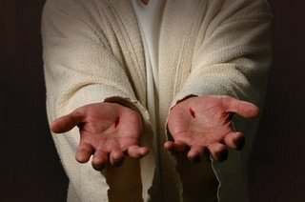
Romans 12:5
In Christ, we who are many form one body, and each member belongs to all the others.
See! I Will Not Forget You. I Have Carved You on the Palm of My Hand.
Isaiah 49:15
Prayer: Father, help each of us to make a difference to that one. Lord Jesus, teach each of us to live our lives on this earth like You did – making a difference in people’s lives, one by one.

