Slide 1
Framing and Reframing
Putting it all Together:
Thinking, Listening, Collaborating
By: Cynthia Summers

Slide 2
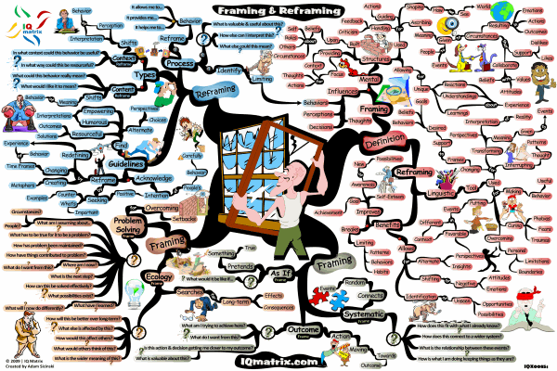
http://blog.iqmatrix.com/wp-content/gallery/life-success-series/framing-reframing-mind-map-b-800px.gif

Slide 3
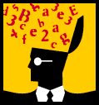
http://www.mindmapart.com/framing-reframing-mind-map-adam-sicinski/

Slide 4

“Our stories become our maps.”

Slide 5
Once upon a time there was a student who “got stories.” She became known as the Story Seeker. Her desire to learn was unsurpassed. At each storytelling opportunity, she took from her backpack, a bright, fresh set of eyes and an inquisitive mind. She listened for the storyteller’s point. At times relevance rolled over her like a freight train and she connected. Other times it didn’t. After all, she hadn’t traveled far down the road of life. So she made notes. If she detected empathy and decent humanness within the storyteller, she committed a lifeline to her. Relevance might come one day, but only if they remain connected.
The storyteller who cares, plants the seeds from which future storytellers can grow. How special the moment, when one inspires another to tell a story.
http://blog.kevineikenberry.com/leadership/five-reasons-stories-are-a-powerful-communication-tool
/
Cheryl

Slide 6

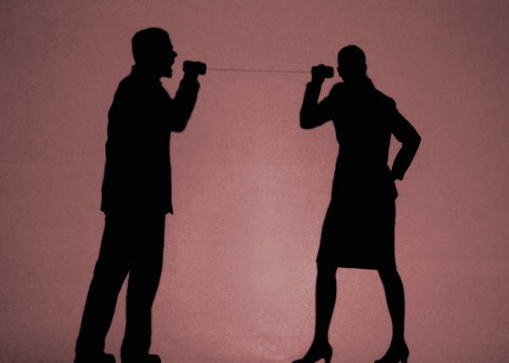

Listening
Storytelling
Participatory Learning

Slide 7




“We have to be a learner at all times.”
http://psychology.about.com/od/educationalpsychology/tp/effective-learning.htm
Plearn =
Participatory Learning
Plearn =
Participatory Learning

Slide 8
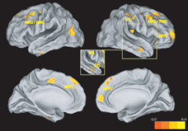
Columbia University researchers have shown for the first time that two brain systems are primarily responsible for allowing humans to accurately predict the emotions of others.
The human brain.....
1. is unique in each individual
2. seeks meaning
3. seeks and generates patterns
4. responds to stimulating environments
5. responds to active involvement
6. involves both conscious and unconscious activity
7. interacts with emotions and psychological functioning in general
8. connects new experiences to familiar experiences and structures
9. receives through both focused and peripheral perception
10. responds to challenge; is inhibited by threat and anxiety
http://www.sciencedaily.com/releases/2008/07/080711080957.htm
Feeling
http://www.selfdirectedlearning.com/article3.html
Thinking

Slide 9
More participatory learning

Slide 10
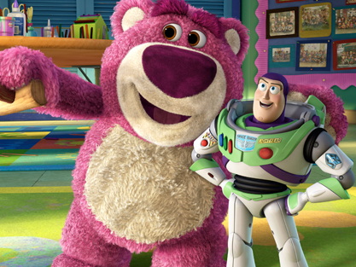
INNOVATION
Video of Pixar's Movies and the Collaborative Age
Creativity thrives in Pixar's animated workplace
Creativity thrives at Pixar studios, where fun begins at drawing board

Slide 11
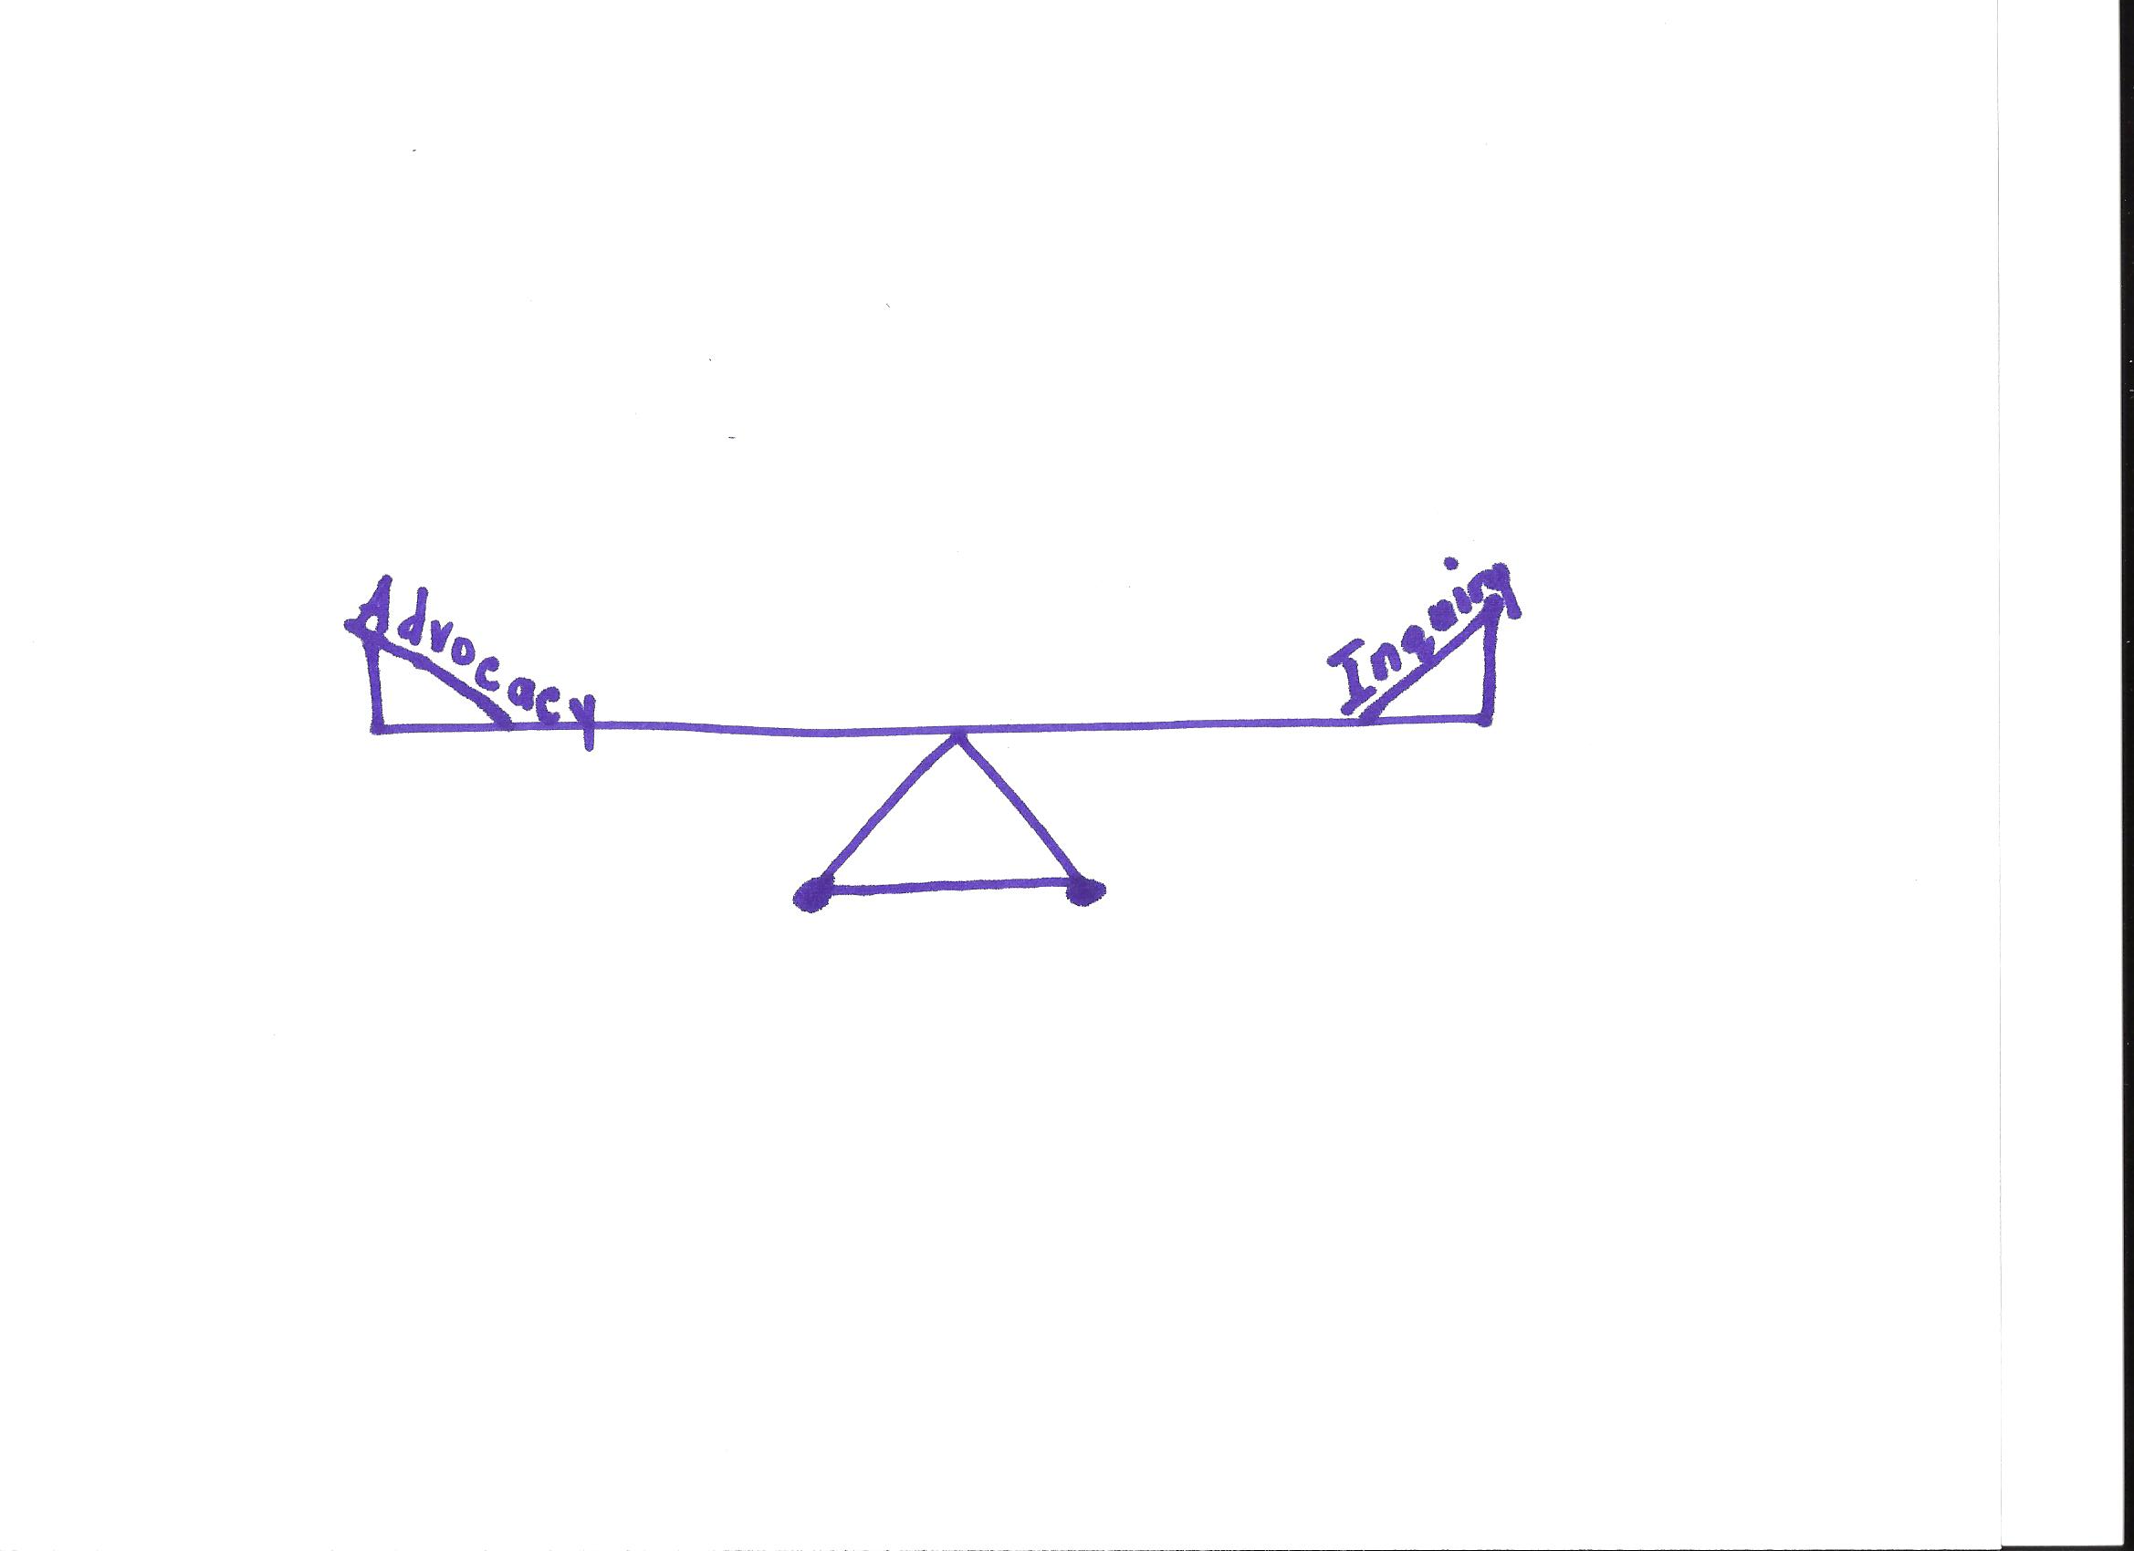
“It’s not how I am and how I see it, but inquiring how is it in your world.”
A.A. Milne (Winnie-the-Pooh)

