Slide 1
Howard Gardner and Multiple Intelligences
Presented by: Steven Yang and Cyndi Summers
Resources from the information provided by: Susan Stevens ,Terri Bell,Jen Meltzer and Diane Fontinell
Notes:
Introduction slide.
Susan.stevens@birdvilleschools.net

Slide 2

Who is this man?
Click here for the answer.
Notes:
Photograph of Dr. Howard Gardner

Slide 3
The man on the previous slide is Howard Gardner. Dr. Gardner is best known for his theory of Multiple Intelligence.
Notes:
Students will create a KWL chart to list what they know, want to know and finally what they learned about Multiple Intelligences.

Slide 4

Biography
(1943 - )
Born in Scranton, PA
Professor of Cognition and Education at Harvard
Received many awards
Author of over 20 books
Best known for his theory of multiple intelligences
http://www.howardgardner.com/bio/bio.html

Slide 5





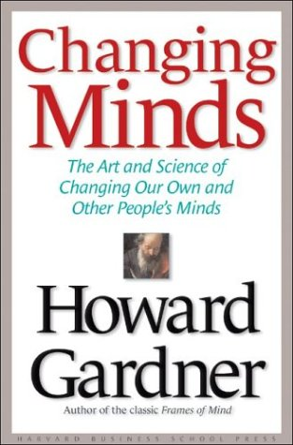
Books
http://www.howardgardner.com/bio/bio.html
Biography

Slide 6
Theory of Multiple Intelligence
Click here to view an interview with Howard Gardner.
Click here to view video clip of the Key Learning Community.
Click here to view video clip on Differentiated instruction.
Notes:
These three activities will give students a good overview of Howard Gardner’s theory of Multiple Intelligence. http://www.edutopia.org/multiple-intelligences-howard-gardner-video
Students will view an actual interview featuring Gardner. They will then make a recording of their own interpretation of what Multiple Intelligences are.
Video segment from Edutopia about Multiple Intelligences and No Child Left Behind and the Key Learning Community in Indianapolis http://www.edutopia.org/multiple-intelligences-key-learning-community-video original video http://www.edutopia.org/key-learning-community
The last clip is about differentiated instruction. The 4th grade teacher does a great job with multiple intelligences in her classroom. Students are asked to observe the video and write about their observations.

Slide 7
What’s your learning style?
Take a quiz.
When you finish the quiz, look at your results. What are your two strongest learning preferences?
Describe your favorite lesson ever at school. Why do you think you remember it? Class discussion.
Notes:
This activity takes the students to a quiz that will evaluate their own learning styles. When finished they will print their learning styles preferences and evaluate their own preferences. Students will discuss in class their favorite lesson ever in school. Knowing what they know now, why do they remember it? How big an influence are learning preferences to student engagement?

Slide 8
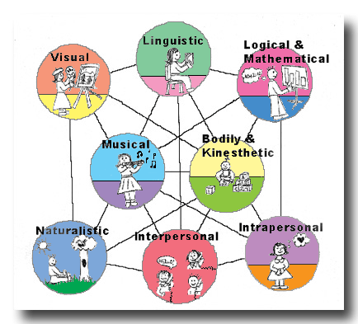
Citations
Notes:
Students can refer to the visual chart with images to represent the multiple intelligences.
Students can visit the Discovery Education website and search to locate a suitable activity for their learning preference.

Slide 9
Gardner defines intelligence as:
The ability to create an effective product or offer a service
A set of skills that make it possible to solve problems
The potential for finding or creating solutions for problems, which involves gathering new knowledge.

Slide 10
Human beings have nine different kinds of intelligences
Each person has their own unique combination

Slide 11
Types of Intelligences:
Linguistic
Logical/mathematical
Musical rhythmic
Bodily/kinesthetic
Spatial
6. Naturalist
7. Intrapersonal
8. Interpersonal
9. Existential

Slide 12
Technology and Multiple Intelligences –
“Computers offer students a multi-sensory smorgasbord,” which engages learners by stimulating the multiple intelligences.
        Jane Carlson-Pickering

Slide 13
Technology
The following slides will show how teachers can use technology with the multiple intelligences.

Slide 14


Verbal / Linguistic Intelligence
Word Processing Programs
Spell Checkers
Desktop Publishing Programs

Slide 15

Logical / Mathematical
Internet
Computer Software – math games, logic games, etc.
Spreadsheets
www.funbrain.com

Slide 16

Visual / Spatial Intelligence
Draw and Paint Programs
Clip Art
PowerPoint

Slide 17
Bodily / Kinesthetic Intelligence
Video Games
Virtual Reality
Interactive White Boards

Slide 18

Naturalist Intelligence
Virtual field trips
Expeditionary activities online

Slide 19
Interpersonal Intelligence
Work in groups to use software or technology
PowerPoint
Email
Use databases or spreadsheets to create school-wide surveys and graphs

Slide 20
Intrapersonal Intelligence
Word processing program – journal
Math Programs – create individualized programs for students

Slide 21
Awesome Website on MI Theory Resources
http://www.lth3.k12.il.us/rhampton/mi/mi.html

Slide 22
Notes:
Texas Essential Knowledge and Skills can be found at the Texas Education Agency website.
Crosswalks and new curriculum standards have been put in place for the 2010-11 school year for Career and Technical Education.
www.tea.state.tx.us

Slide 23
Works Cited
Carlson-Pickering, J. 1999. Teachers in Technology Initiative. June 10, 2008, from http://www.mcmel.org/erica.mi/technology.html
Great Performances. Howard Gardner’s Multiple Intelligences Theory. June 9, 2008, from http://www.pbs.org/wnet/gperf/education/ed_mi_overview.html
Harvard College. 2008. Howard Gardner. June 9, 2008, from http://www.pz.harvard.edu/pis/hg.htm
Harvard Graduate School of Education. 2008. Howard Gardner: Hobbs Professor of Cognition and Education. June 5, 2008, from http://www.howardgardner.com/bio/bio.html
Kagan, S. & Kagan, M. (1998). Multiple Intelligences: The Complete MI Book. San Clemente: Kagan Cooperative Learning.
Smith, M. 2002. Howard Gardner, Multiple Intelligences and Education. June 5, 2008, from http://www.infed.org/thinkers/gardner.htm

Slide 24
Citations
Google images. Photo of Howard Gardner. www.news.harvard.edu/.../ 11.01/11-gardner.html
Texas Education Association. Career and Technical Education - Texas Essential Knowledge and Skills, Course Crosswalks and Coherent Sequences http://www.tea.state.tx.us/index2.aspx?id=5415#Subchapter%20E
Interview with Howard Gardner. Produced for Edutopia byState of the Art© 1997The George Lucas Educational Foundation All rights reserved http://www.edutopia.org/multiple-intelligences-howard-gardner-video
What’s Your Learning Style Quiz? Edutopia. http://www.edutopia.org/multiple-intelligences-learning-styles-quiz
Discovery Channel School. (2005).Differentiated Instruction in Fourth Grade Mathematics [Video Segment]. Available from http://www.discoveryeducation.com/
Great Ideas in Psychology Podcast. This is a podcast about the great ideas in psychology. http://web.mac.com/todddaniel/Professor_Todd/Great_Ideas_in_Psychology_Podcast/rss.xml
Multiple Intelligences Graphic Image chart. http://www.new-oceans.co.uk/new/education/images/multint2.gif
Edutopia. Video clip from 2001. No Child Left Behind. http://www.edutopia.org/multiple-intelligences-key-learning-community-video
Notes:
Citations used for research.

