Slide 1
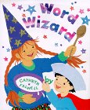
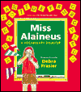
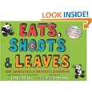
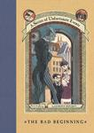
“Favorite Titles for Creating Word Detectives and Stretching Vocabulary”
Karen Bromley
Binghamton University
kbromley@binghamton.edu
55th IRA, Chicago, IL 2010

Slide 2
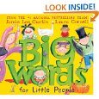
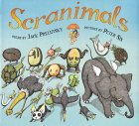
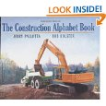
Word Wizard by Cathryn Falwell (1998). New York: Houghton Mifflin (Gr. K-3). With a magic spoon and alphabet cereal, young Anna and Zack discover how to rearrange letters to make new words.
Big Words for Little People by Jamie Lee Curtis & Laura Cornell (2008). New York: Harper Collins (K-3). With rhyming prose and colorful characters , young children are introduced to BIG WORDS like: amazing, hilarious, spectacular, advocates, appreciates, stunning, competent, rotund, reside, supreme, intelligence, etc.
Scranimals by Jack Prelutsky (2002). New York: Greenwillow (K-6). A collection of funny poems about a trip to Scranimal Island, the home of exoctic compounded animals like spinachickens, broccolions, hippopotamushrooms and porcupineapples.
The Construction Alphabet Book by Jerry Pallotta (2006). New York: Charlesbridge (K-3). “Rock crushers, jackhammers, and wrecking balls tear up the pages of this noisy ABC book.” www.alphabetman.com Jerry has written over 50 ABC books.

Slide 3
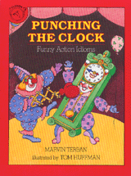
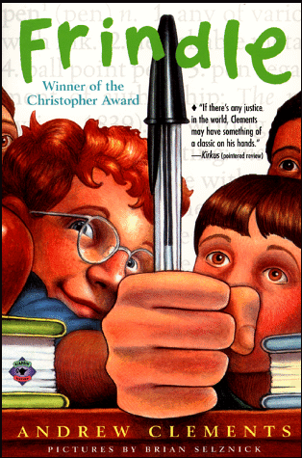
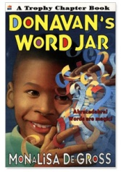
Punching the Clock: Funny Action Idioms by Marvin Terban (1990). New York: Clarion (Gr. 1-5). A funny collection of idioms and their origins with illustrations.
Frindle by Andrew Clements (1998). New York: Alladin (Gr. 2-4). When Nick learns how words originate he decides to call his pen a frindle, a term his classmates, the community and the country adopt.
Donovan’s Word Jar by Monalisa DeGross (1998). New York: Harper Trophy (Gr. 3-6). A young African American boy loves new words and collects them on slips of paper he puts in his word jar. His grandmother helps him figure out what to do when the jar is full.
Miss Alaineus: A Vocabulary Disaster by Debra Frasier (2000). San Diego: Harcourt (Gr. 3-6). Home with the flu, Sage misunderstands the weekly vocabulary words her friend gives her which is the beginning of a funny story filled with hundreds of words and definitions.

Slide 4
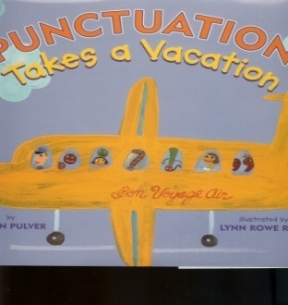
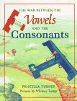
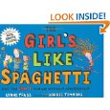
Punctuation Takes a Vacation by Robin Pulver (2003). New York: Holiday House (Gr. 1-6). When all the punctuation marks in Mr. Wright’s class decide to take a vacation, the students discover just how difficult life can be without them.
The War Between the Vowels and the Consonants by Priscilla Turner (1999). New York: Farrar. (Gr. 1-3). In this story vowels and consonants become characters in separate communities whose mutual irritation with the other escalates into war. It sows seeds for thought about how letters work together and how people live together.
Eats, Shoots & Leaves: Why, Commas Really Do Make a Difference! by Lynne Truss (2006).New York: Putnam (Gr. 1-4). “ If you are tired of explaining & re-explaining the importance of punctuation in writing, then this is the book for you.” (There is a version for older students, too).
The Girl's Like Spaghetti: Why, You Can't Manage without Apostrophes! By Lynne Truss (2007). Putnam (Gr. 2-5). “Eat here, and get gas!” or “Eat here and get gas.” Children will gain an instinctive understanding of the traffic signals of language.” (Booklist)

Slide 5
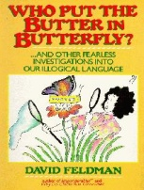
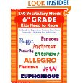
The Last of the Really Great Whangdoodles by Julie Edwards (1999) New York: Harper Collins (Gr. 3-6). Professor Savant teaches three children to see the world in a different way as they visit Whangdoodleland, a special place full of extraordinary creatures like furry Flukes, the High-Behind Splintercat and the Wonderful Whiffle Bird.
Who Put the Butter in Butterfly and Other Fearless Investigations into Our Illogical Language by David Feldman (1990). New York: Harper Collins (Gr. 3-6). Explanations of the origin of words, curious clichés and phrases including such terms as jaywalking, ladybug and why an outdoor bazaar is called a flea market.
The 6th Grade Nickname Game by Gordon Korman (2000). New York: Hyperion (Gr. 5-6). Best friends, Jeff and Wiley create nicknames for everyone including their class - the dim bulbs and the principal - a deer in headlights as they adjust to a new teacher.
240 Vocabulary Words 6th Grade Kids Need to Know by Linda Beach (2003). New York: (Gr. 4-6). Contains exercises for learning synonyms, antonyms, homonyms, Greek & Latin roots, etc. Also books for 5th, 4th and 3rd grades.

Slide 6
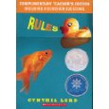
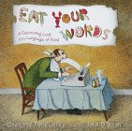
Scholastic Dictionary of Idioms by Marvin Terban (1998). New York: Scholastic (Gr. 3-9). A collection of common idioms with their literal and figurative definitions and illustrations.
Rules by Cynthia Lord (2006). New York: Scholastic (Gr. 3-9). A girl with an autistic brother goes to therapy with him and meets a boy with a speech handicap. She writes rules for her brother and word cards for the boy who cannot talk.
A Series of Unfortunate Events by Lemony Snicket (series, 1999-). New York: Harper Trophy (G r. 4-9). Funny stories about the unlucky adventures of three orphaned children that include colorful and sophisticated words and their definitions and bleak events where things never turn out as you'd hope.
Eat Your Words: A Fascinating Look at the Language of Food by C.F. Jones (1999). New York: Delacourte (Gr. 4-9). Fascinating, historical, and funny stories about the origins of the language of food.

Slide 7
