Slide 1

Helping Paws Healing Hearts
With Amy Hicks
Presented by: Cyndi Summers

Slide 2
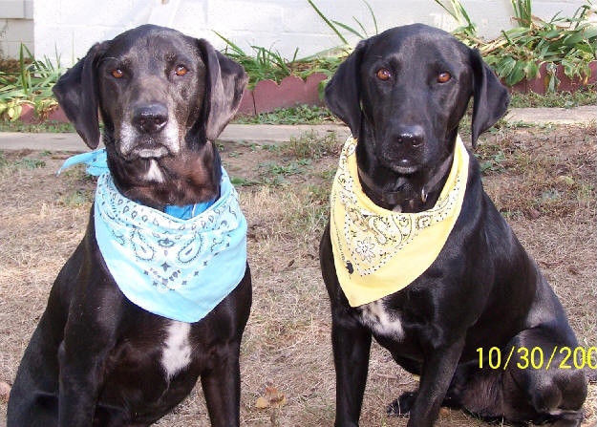
Helping PawsHealing Hearts- Watch a Video about this organization.
http://www.youtube.com/watch?v=5TFCz1pV2co

Slide 3
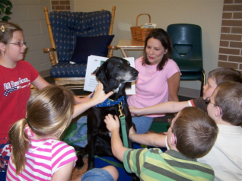
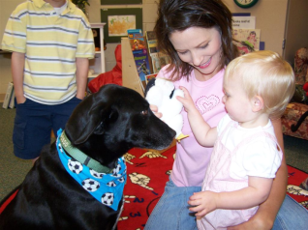

Click Here for their website: http://www.helpingpawsinfo.com/default.htm
Amy Hicks, Larry, Daryl, and Addie

Slide 4

Helping Paws Healing Hearts
Character Tales
Click the book to find out about Larry and Daryl’s adventure!

Slide 5

http://www.makeadifference101.org/
Read Amy’s story in
“The Lemonade Stand”

Slide 6

Therapy Dogs International
What is Therapy Dogs International?
http://www.tdi-dog.org/

Slide 7

Heel the Love
How can the love and attention of a dog, heal you?
http://www.dailycardinal.com/features/heel-the-love-1.2015128

Slide 8
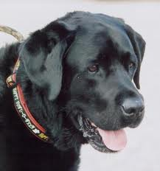
Therapy dogs help children with autism connect!
http://www.autismohio.org/index.php/information-mainmenu-118/general-news/1835.html

Slide 9

Therapy Dogs Lending a Helping Paw to Students
http://www.worldandi.com/subscribers/feature_detail.asp?num=25151

Slide 10


http://www.freekibble.com/
This site donates to hungry animals.

Slide 11
http://www.youtube.com/watch?v=5TFCz1pV2co http://www.helpingpawsinfo.com/default.htm http://www.makeadifference101.org/ http://www.tdi-dog.org/ http://www.dailycardinal.com/features/heel-the-love-1.2015128 http://www.autismohio.org/index.php/information-mainmenu-118/general-news/1835.html http://www.worldandi.com/subscribers/feature_detail.asp?num=25151
References:

