Slide 1


Communities Large and Small
Mrs. Summers 1st Grade

Slide 2
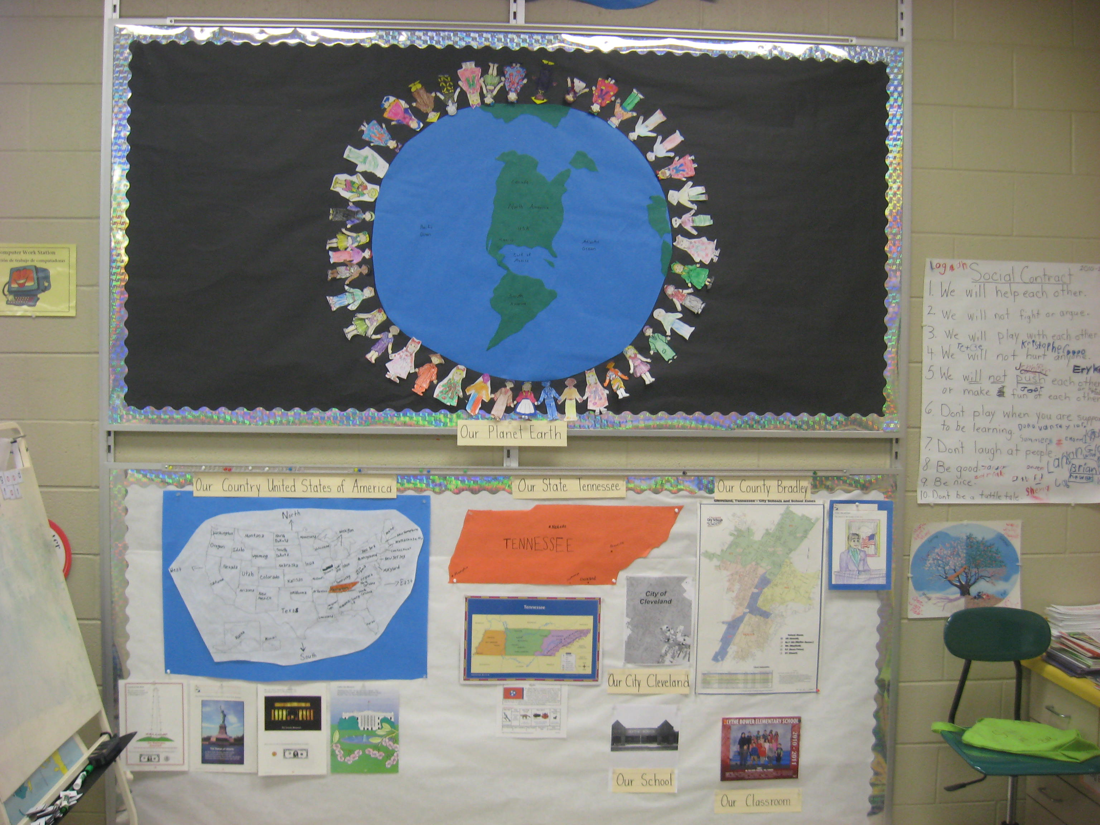

Slide 3
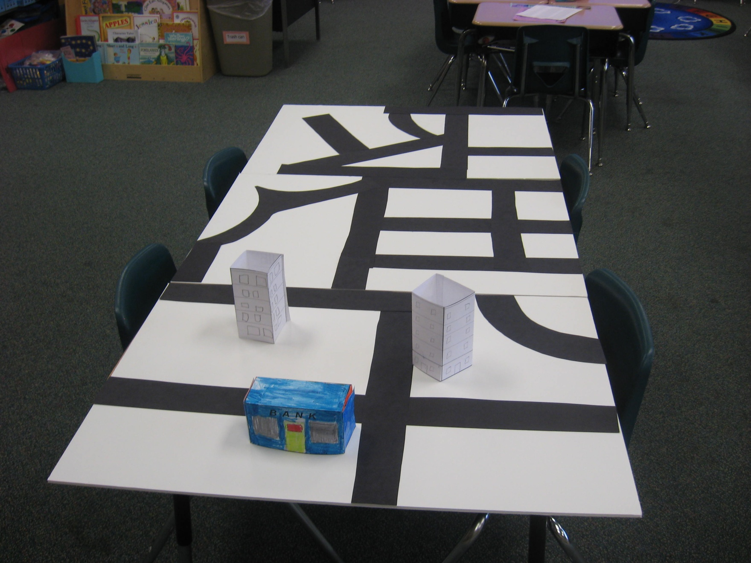

Slide 4
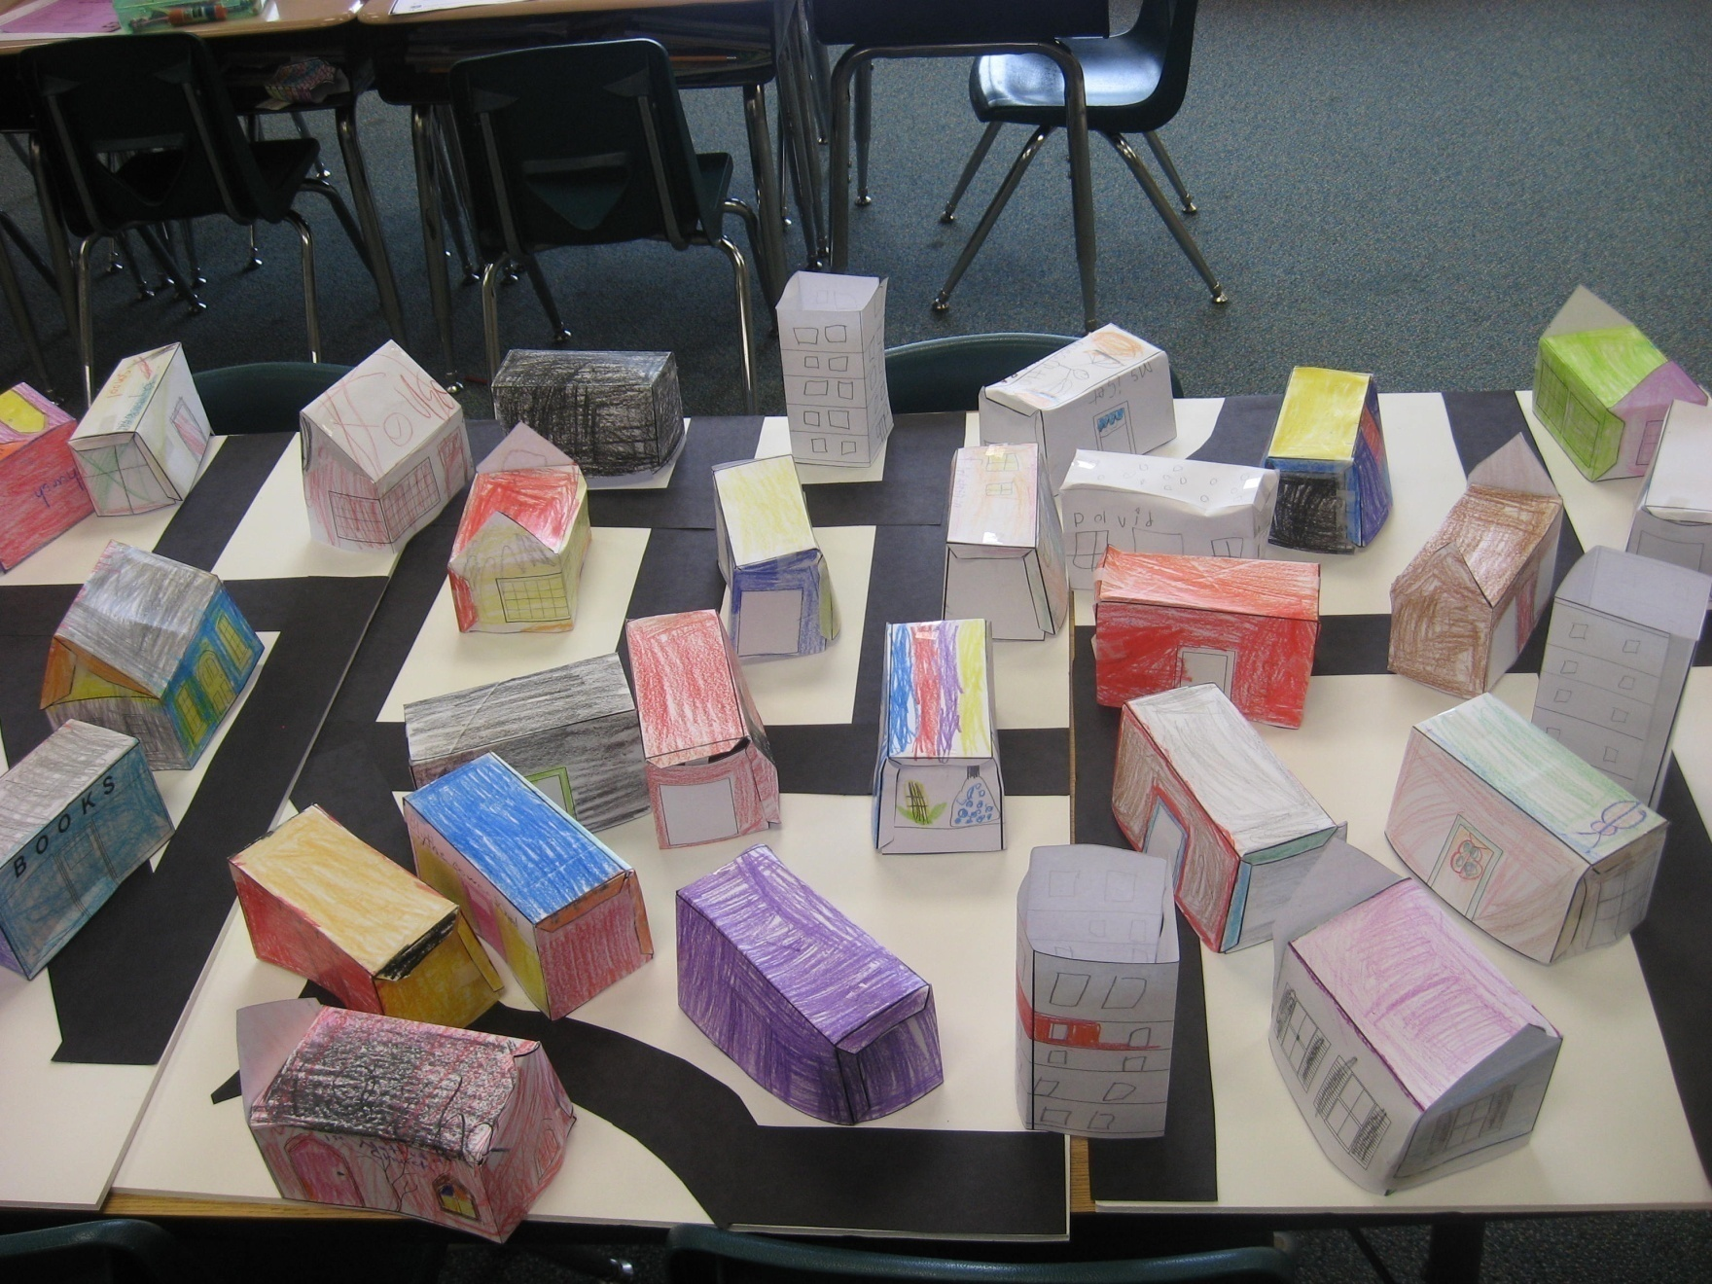

Slide 5
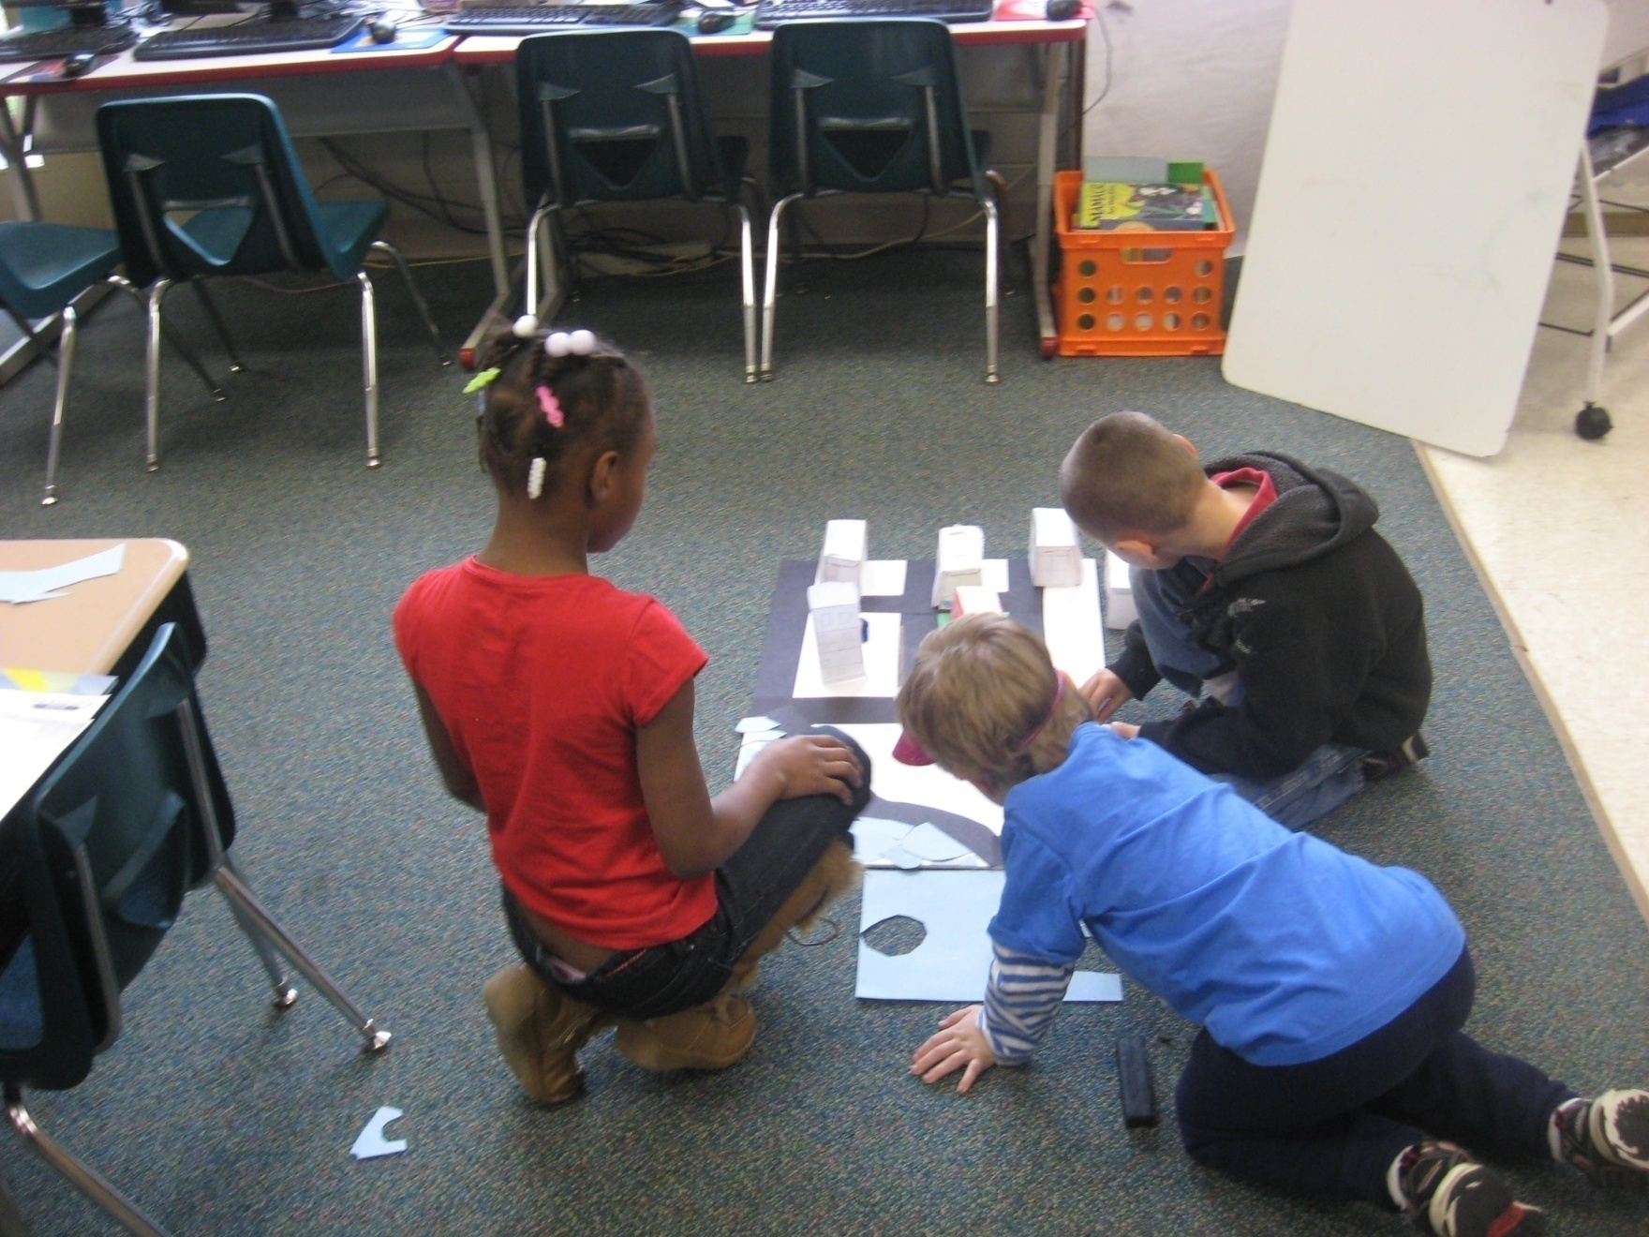

Slide 6
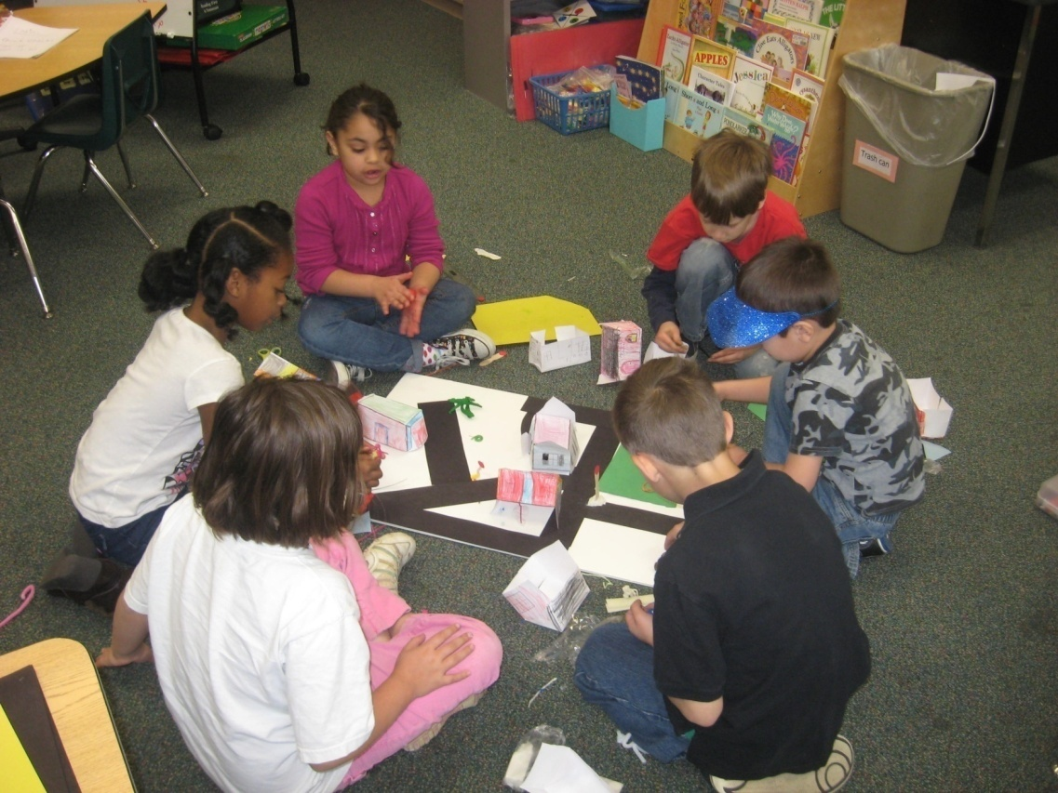
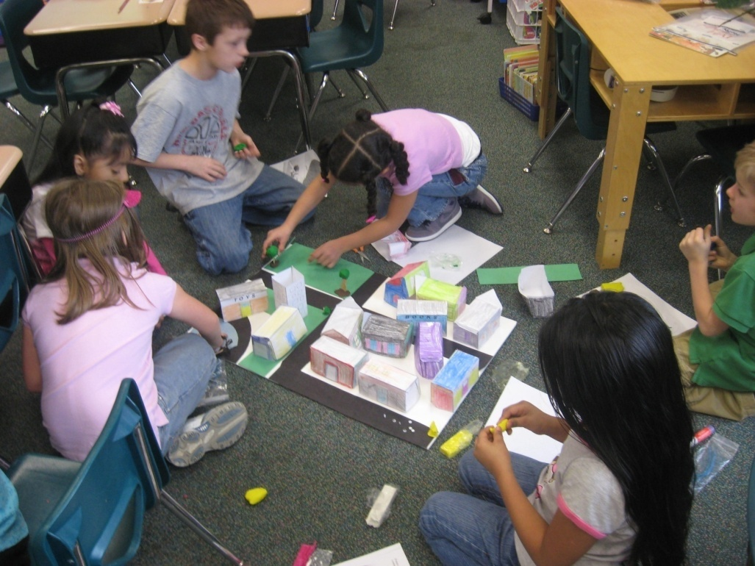

Slide 7
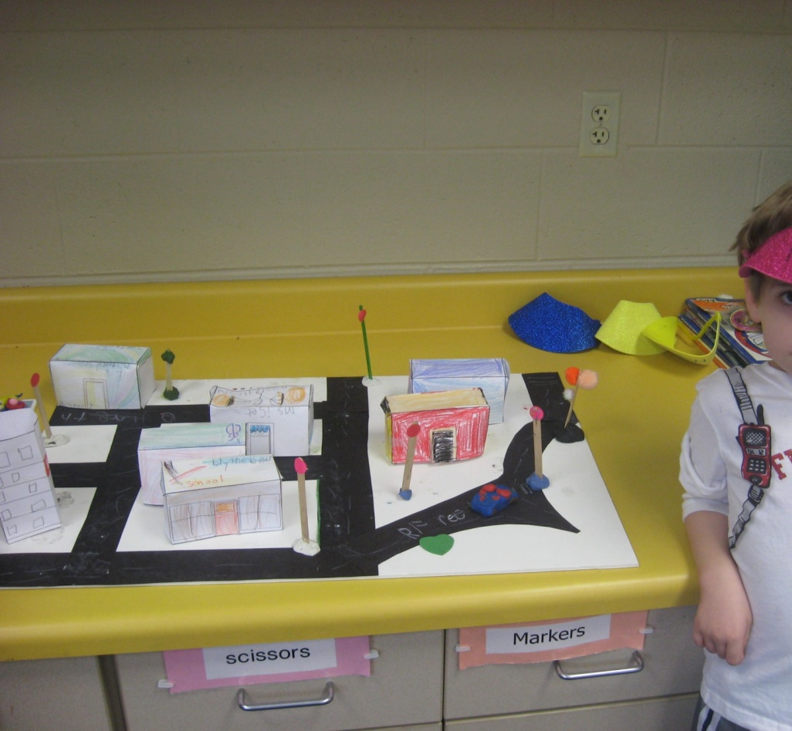
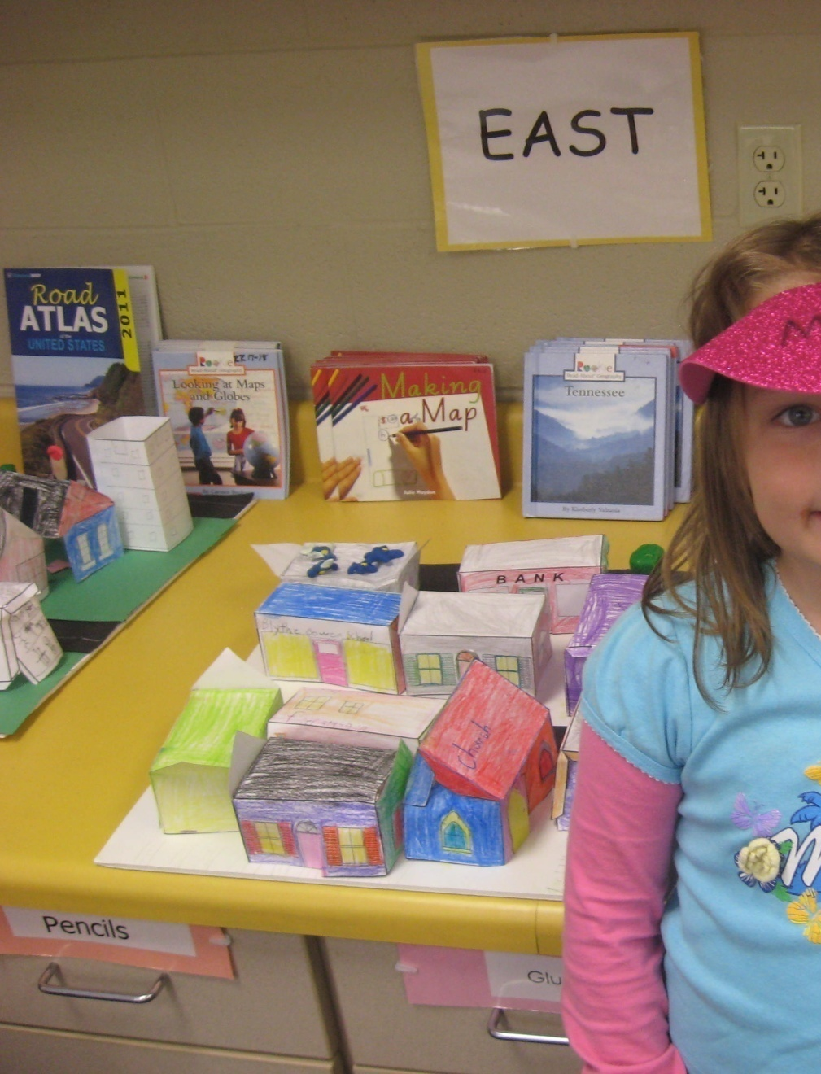

Slide 9
Theme-based Literature on Towns and Communities
The Gardener, Sarah Stewart
The Scrambled States of America, Laurie Keller
Gooseberry Park, Cynthia Rylant
I Love the Mountains, John Archambault
Old MacDonald Had an Apartment House, Judi Barrett
Cloudy with a Chance of Meatballs, Judi Barrett
My Street, Rebecca Treays
My Town, Rebecca Treays
When I was Young in the Mountains, Cynthia Rylant
Theme-based Songs on Towns and Communities
I Love the Mountains, John Archambault
My Home in My Town, John Archambault
This Land is Your Land, Woody Guthrie
It’s a Small World, Richard M. and Robert B. Sherman

Slide 10
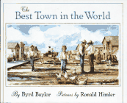
http://www.carolhurst.com/subjects/citiesandtowns.html
Resources:
http://www.yourchildlearns.com/dirtown.htm
Making a town templates

