Slide 1
Arts across the curriculum
Presented by: Cynthia Summers

Slide 2

Integrated Learning
http://www.lessonsense.com/info/integrating-language-arts.html
http://www.artseveryday.org/CulturalOrg/detail.aspx?id=182
http://www.edutopia.org/arts-opening-minds-integration-video
http://www.learner.org/resources/series199.html?pop=yes&pid=2124
http://www.youtube.com/watch?v=AlLKvHlJS50&feature=related
http://www.youtube.com/watch?v=vhxqBFm7WJw&feature=related
http://www.sedl.org/afterschool/toolkits/arts/pr_integrating.html
http://www.mcc.cc.ms.us/techprep/lessons.htm
Reasons for Readalouds
http://www.esiponline.org/classroom/foundations/reading/readalouds.html

Slide 3
When skills teaching and content are tightly coupled with stories and activities, the skills that are taught build a web of connections for retention.
The teacher's chain of reasoning is :
*What concepts can I teach and connect?
*What activities and assignments will the students be doing?
*What skills will students need to carry out the activities and assignments?
*An instructional sequence is then generated to help students develop the selected skills, with an eye toward improving their performance in the content learning activity.
*What other stories might connect and build onto the new learning?
http://www.edzone.net/~mwestern/stuff.html

Slide 4

Read-Aloud Books…and the Routines and Reasons
You Read to Me, I’ll Read to You by Mary Ann Hoberman
The Red ABC Songbook
“If You Really Love to Read….”
Naughty Word Monster!
The Monster at the End of this Book
by Sesame Street
http://www.suu.edu/faculty/lundd/readingsite/readingresources/LiteracyCurricula/index.html
“Ten To-Dos for Successful Read Alouds”
http://www.ala.org/ala/aboutala/offices/publishing/booklinks/resources/Read-alouds.pdf
http://www.memfox.net/ten-read-aloud-commandments.html

Slide 5



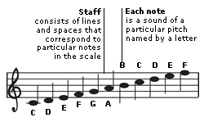
Favorite Read-Alouds & Activities
http://www.inventionatplay.org/
The Great Fuzz Frenzy
by: Janet Stevens and Susan Stevens Crummel
Art & Writing Activity: What would you make with the fuzz?
Building Concepts: Use marbles and blocks to construct replicas
Music: Down the scale
Drama: Act out the story
Words: Explore word descriptions
Math: Measuring time or length of falling objects
Science: Down the river or gravity
http://www.frontiernet.net/~imaging/play_a_piano.html
http://www.youtube.com/watch?v=Xtk_bqkfeyE
http://www.youtube.com/watch?v=ghPSl3j0gE4

Slide 6
Royal Books With Regal Applications
http://cyndislearning.weebly.com/

Slide 7
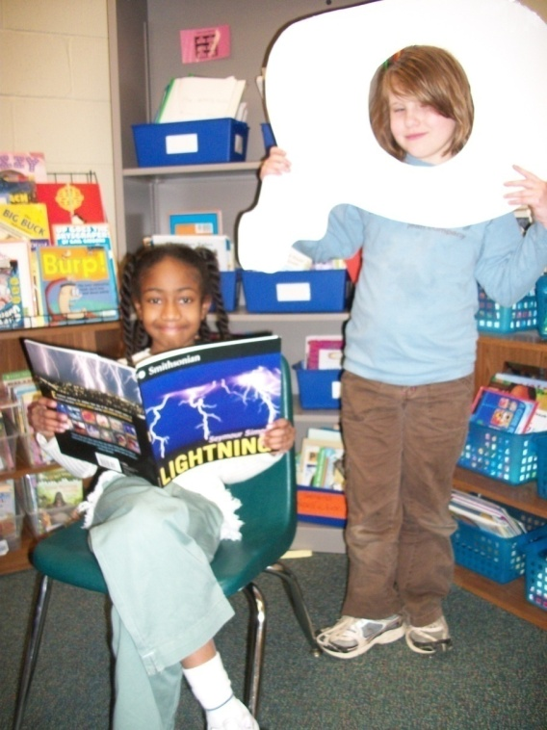
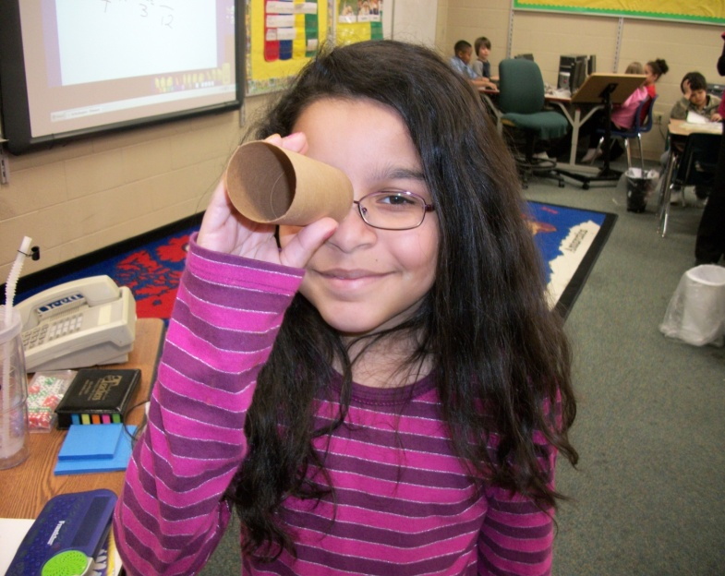
Tools
Visualizing is like having a motion picture in your mind.

Slide 8
“Just reading a book doesn’t always make things stay in your head, but when you do a skit or make up a song verse, you remember the book.”
Props and Puppets….

Slide 9

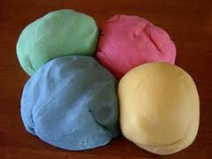

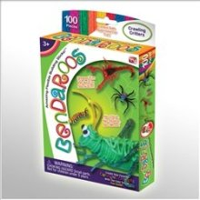
Arts & Crafts…
http://www.youtube.com/watch?v=5f3u2-NCF-s&feature=related
http://www.youtube.com/watch?v=2B_v2uc38Mg&feature=related

Slide 10


http://mrsjonesroom.com/songs/alphlist.html
http://kids.niehs.nih.gov/music.htm
http://www.classicsforkids.com/teachers/
http://www.artinaction.org/webpage/curriculum
http://www.ecb.org/surf/intart.htm#high
http://www.educationworld.com/a_curr/curr146.shtml
http://library.thinkquest.org/4116/
http://www.carolhurst.com/subjects/time.html
http://www.nellieedge.com/movie_nononsense.htm
http://www.scienceinschool.org/2007/issue5/music

Slide 11
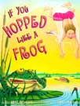

Language Connection:
I have eyes like a hawk!
I have a nose like a hound dog!
He eats like a pig!
He runs like a tiger!
Have you ever used any of these phrases? What do you think the person was saying? ( They all are comparing a human to an animal .) What is a comparison? ( Looking at this to find similarities and differences ) Why do we compare? Let's take a closer look with a story.
Integrating Picture Story Books into the Algebra I and Geometry classrooms
Science
Literature
Math
http://www.utc.edu/Administration/DepartmentalHonors/PoffL.pdf
If You Hopped Like a Frog, by David Schwartz
By setting up a proportion: http://www.aaamath.com/B/g62b_fx1.htm
Length of human body = Length of frog body
Length of human leap = Length of frog leap
As the lesson continues, students are required to set up their own proportions in order
to justify other of Schwartz’s assertions.
http://news.softpedia.com/news/10-Thing-You-Did-Not-Know-About-Croaking-67126.shtml
Soc. Studies
http://www.knowitall.org/swampstories/index.cfm
http://kozmicdreams.com/Teaching/Level%201/Graphite/symmetrical%20frog.jpg
Art

